Slide 1
IOTA- India Section

Slide 2
Background
Jyotirvidya Parisanstha, Pune (India)…
India’s oldest Amateur Astronomers association
Established in August 1944.. Now going to complete its 76 years
Besides popularization activities, some serious astronomy:
Variable star observation through observatory with telescope in dome.. More than 10000 stars observation to its credit accepted by AAVSO
Sky survey for transients
Recently started occultation observations

Slide 3
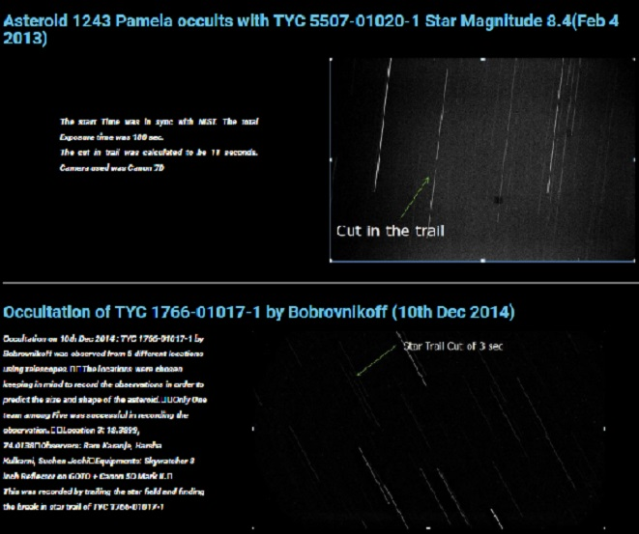
Started with sort of pleasure activities with very crude measurements’

Slide 4
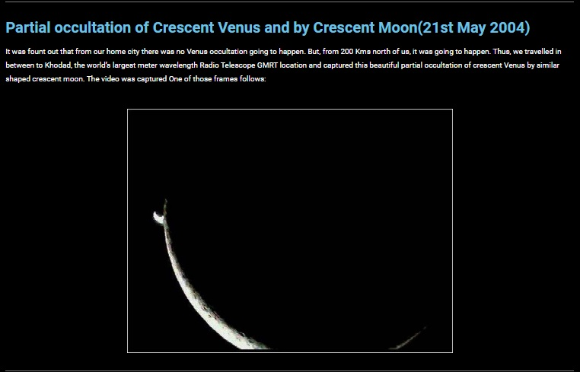
IOTA- India Section

Slide 5
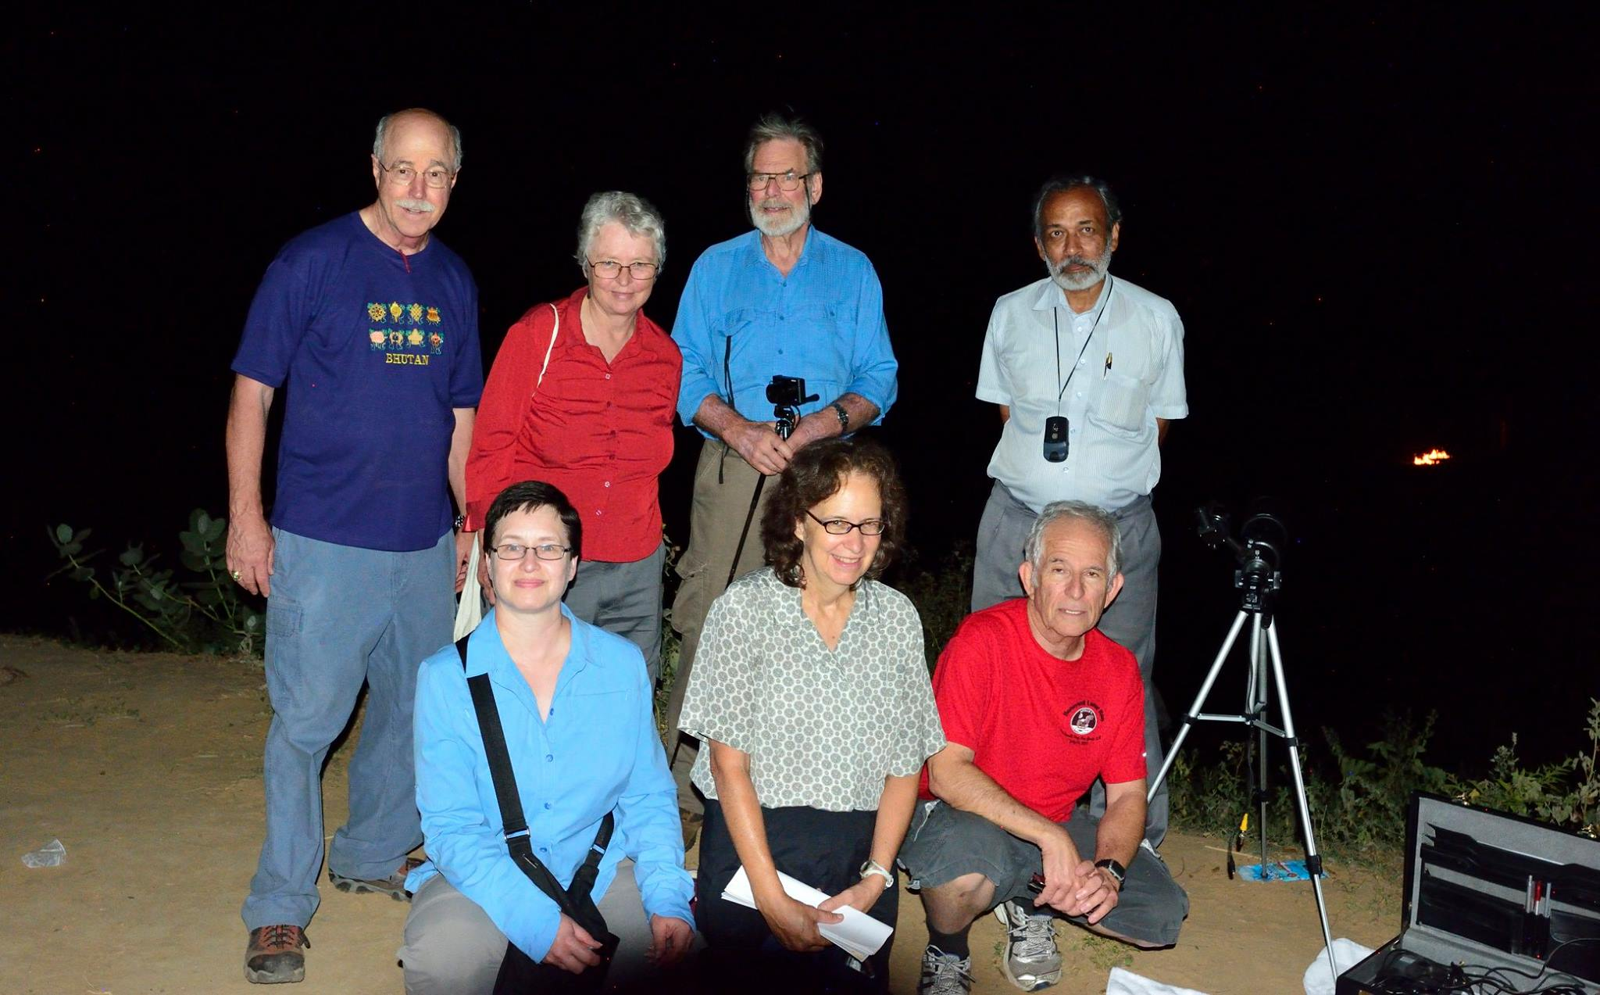
IOTA- India Section
Real Occultation observations started, when Paul Maley was in India for Asteroid Occultation observation in 2015 and we assisted him in site selection and logistics, besides actual observation

Slide 6
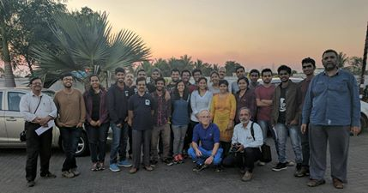
IOTA- India Section
In December 2016, Paul again visited India, and we organized multi-station Asteroid occultation observation of 22 Kalliope successfully. 20 Stations were established over 150 kms on the asteroid path right angle line. 8 Video stations and 12 visual station

Slide 7
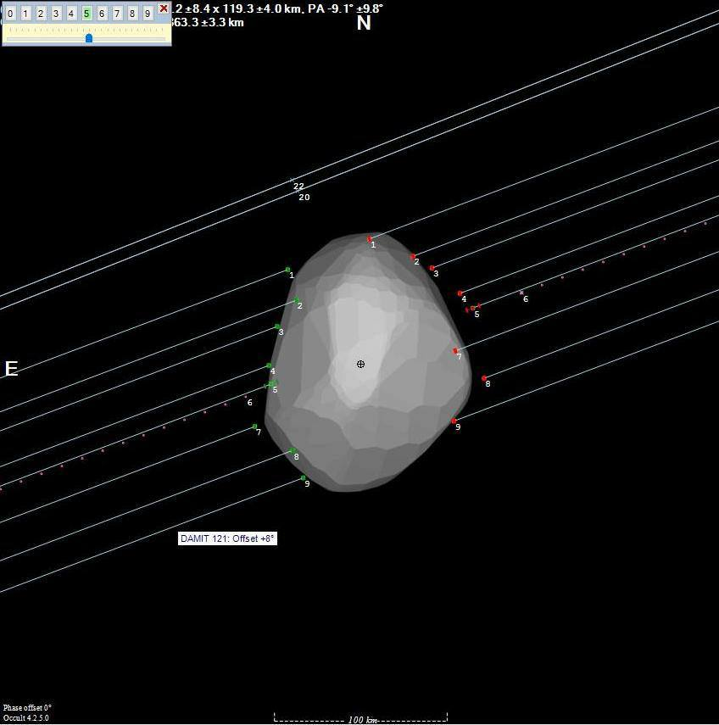
IOTA- India Section
The Result

Slide 8
As there was no other IOTA site, where information relevant to India was being published, we offered to start IOTA- India section. It was accepted, thanks to IOTA office bearers On 3rd May 2019, India section site was launched.. http://iota-india.in/
IOTA- India Section

Slide 9
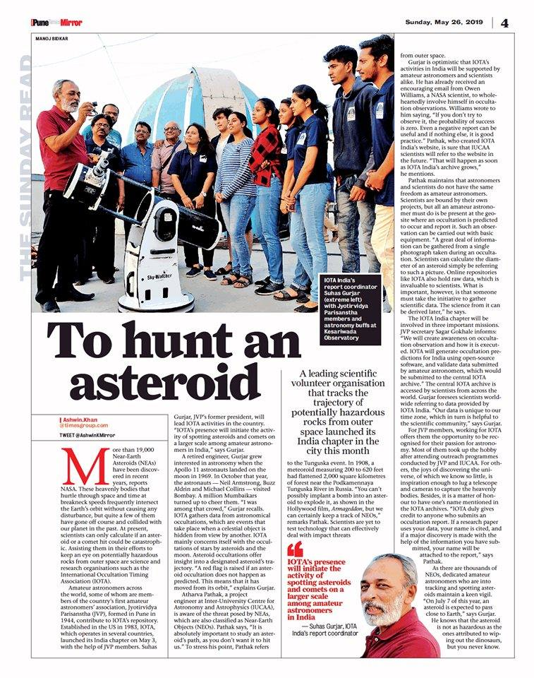
Iota- India Section News in news papers

Slide 10
Iota- India Section Home page

Slide 11
Occultation happening in India (basic information) is published in earlier month for observers to plan the activities.

Slide 12
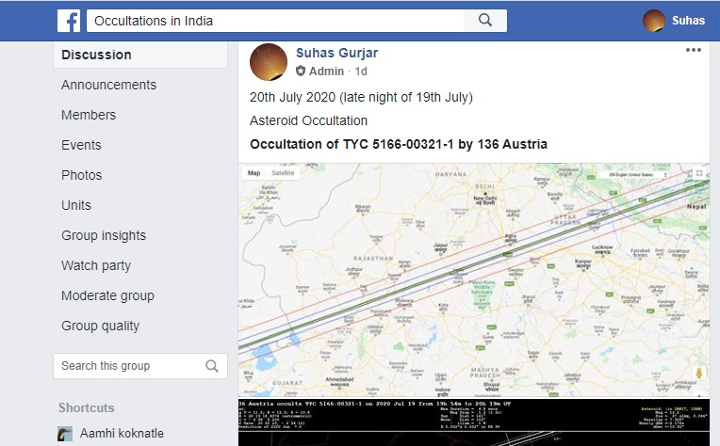
Also, on Facebook group “Occultations in India” basic information (map and general information) of occultation (Asteroid and Lunar) is published daily for next day’s occultations.

Slide 13
On IOTA-India Section site all records of occultations observed are published exactly similar to other International section, with observer’s credit, Star and asteroid detail,
observation reduction etc.
During last year, we could capture two asteroid occultations successfully and one occultation didn’t happen as per prediction.

Slide 14
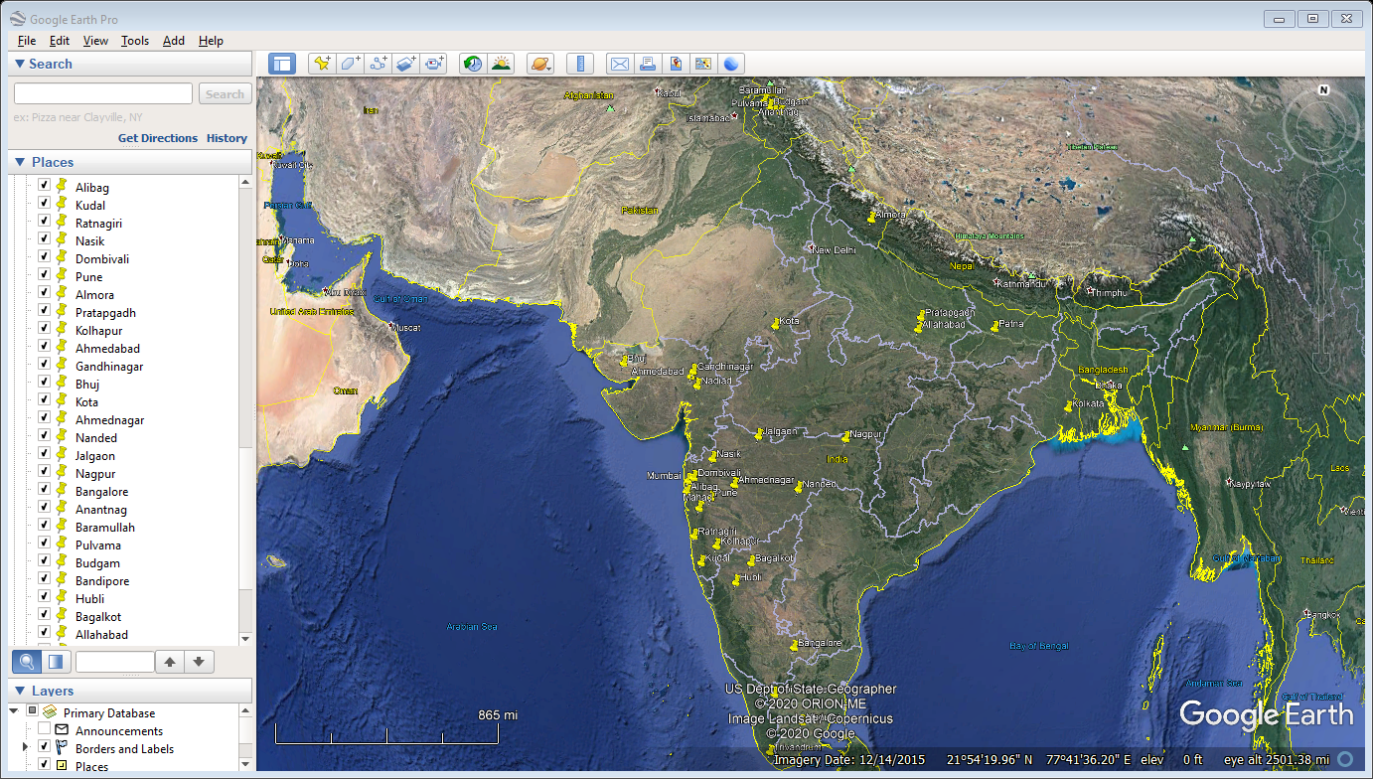
Future plans: Already identified some 30+ station through out India, where some observers are there with telescopes and contacted around 20 of them, who are willing to observe the occultation

Slide 15
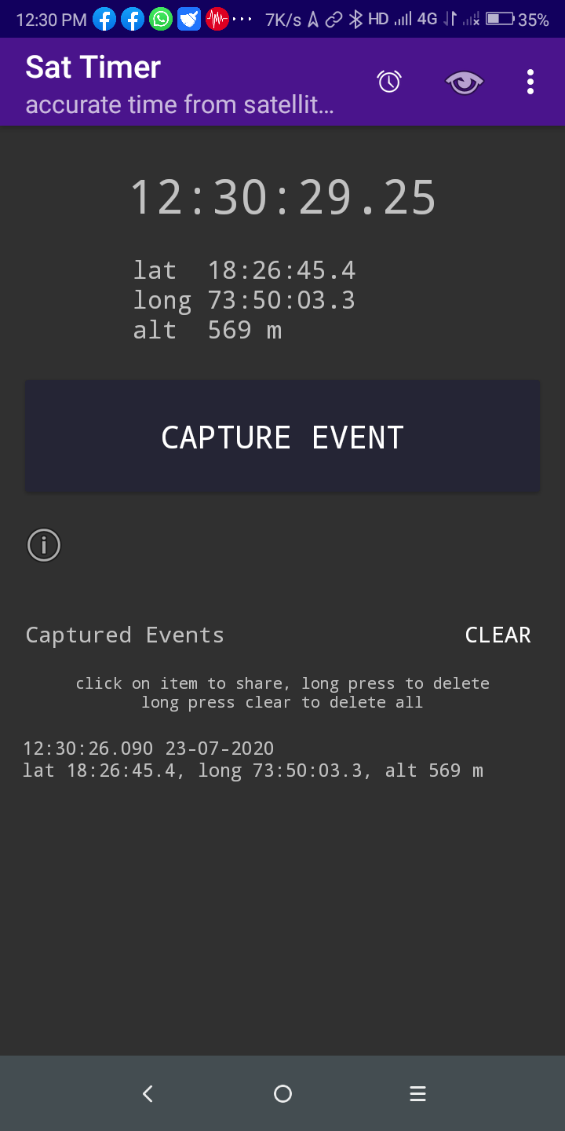
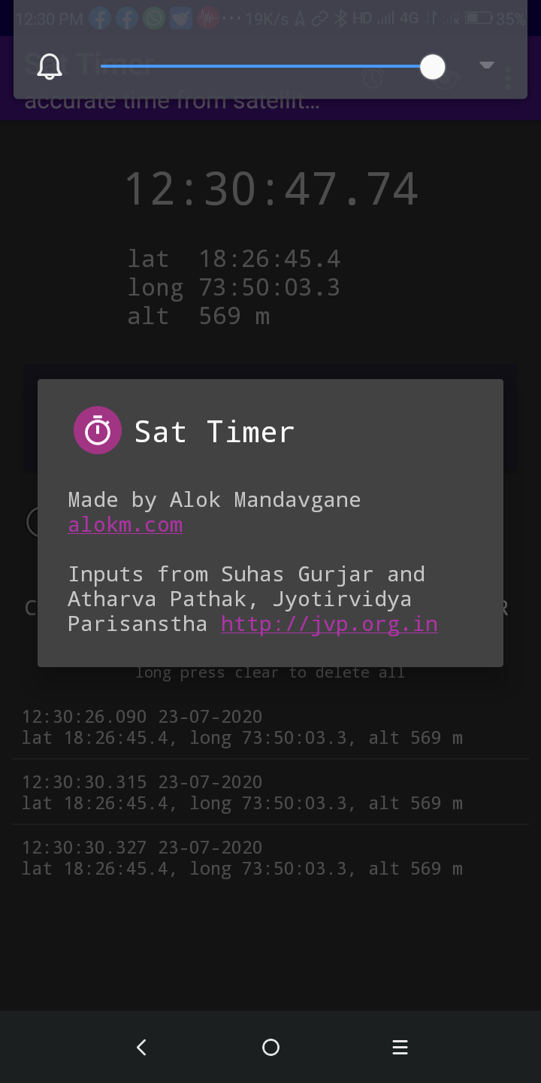
We recently developed Android App “Sat Timers”, which gives location longitude, latitude and altitude and the event time from GPS with ms resolution on the click of a volume button
The earlier known to us similar app “Time the Sat” doesn’t get installed
on all cell phones.
Thus, we developed this app

Slide 16
Main hurdle in developing the observers for Asteroid occultations is the cost of complete kit, which is really beyond the capacity of the average Indian person. Total cost, including duty goes above US$ 800. (Still I personally purchased it recently.
We at Jyotirvidya Parisanstha have two sets of video recording, thanks to Paul Maley, who donated us two time inserts and we purchased other necessary items like Camera and focal reducers.
I am trying to make such kits in India and my target cost will be less than $250 total kit.
I am getting guidance from Steve, Ted and IOTA in this regards

Slide 17
Thanks to Paul, Steve, Ted, David Dunham, Hristo, Felipe, Dave, Tsutomu
Who guided me time to time for my learnings and any sort of problems I faced.
Thanks to IOTA for accepting our proposal of IOTA- India Section
Thanks all for patient listening.

